Slide 1
Al-Farabi Kazakh National University
Higher School of Medicine
DNA repair

Slide 2
LEARNING OUTCOMES
As a result of the lesson you will be able to:
explain what a mutation is and its importance for evolution of life;
explain the importance of DNA repair;
explain the mechanisms of base excision, nucleotide excision, homologous recombination, non-homologous end joining modes of repair.

Slide 3
Literature
Alberts et al., pp. 266-287;
Karp, pp. 552-557

Slide 4
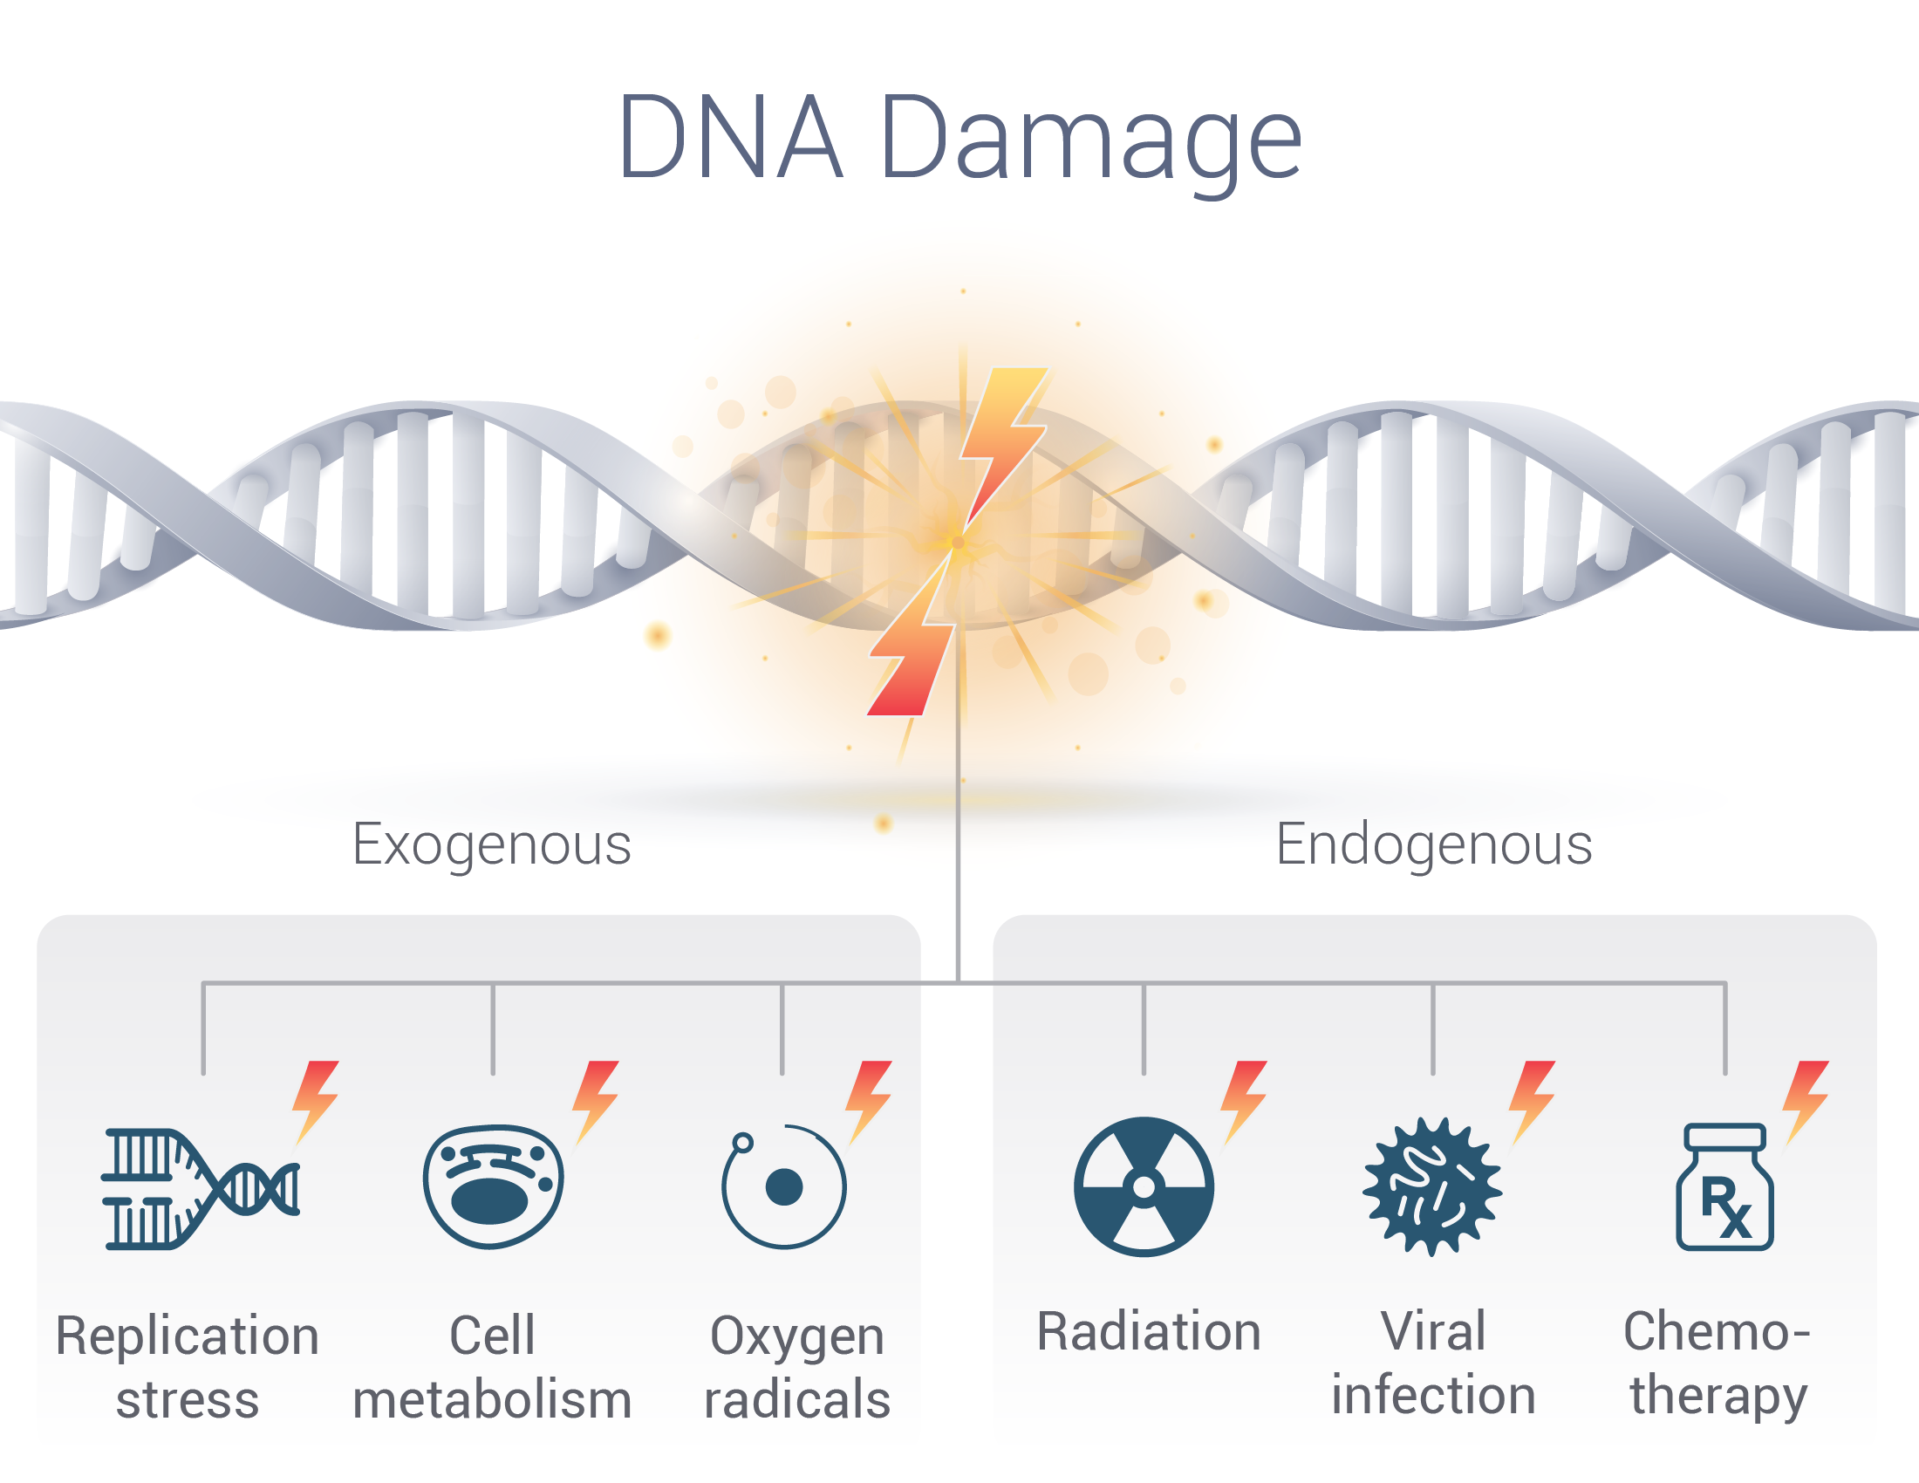
In bacterium E. coli, more than 50 genes are known that control repair processes.
Every day in the DNA molecules of each cell of the human body about 100,000 units are damaged due to a variety of endogenous processes and exogenous genotoxic effects.
Less than 1 DNA damage out of 1000 turns into a mutation.

Slide 5
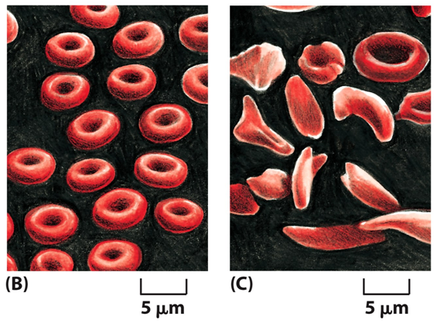
DNA REPAIR
Mutations can have severe consequences for an organism
Mutation: A permanent change in the DNA due to a failure in DNA replication or DNA repair mechanisms.
Even a single nucleotide change may cause severe diseases.
example: a life threatening disease, sickle cell anemia.
--- amino acid sequence change in β-globin chain.
--- red blood cells are more fragile and break frequently in blood stream, reduced number of cells
--- can cause weakness, dizziness, pain etc.
Cells from sickle cell anemia patient
Normal red blood cells

Slide 7
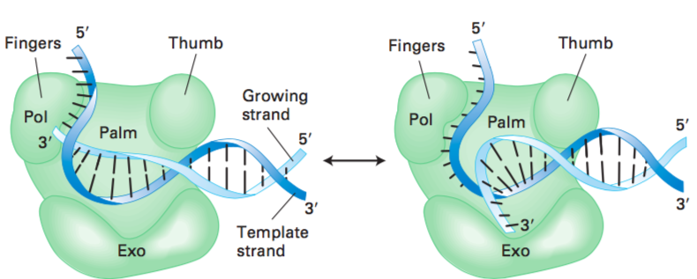
DNA Polymerases Introduce Copying Errors and Also Correct Them
Proofreading by DNA polymerase. All DNA polymerases resemble a half-opened right hand. The “fingers” bind the single-stranded segment of the template strand, and the polymerase catalytic activity (Pol) lies in the junction between the fingers and palm. As long as the correct nucleotides are added to the 3′ end of the growing strand, it remains in the polymerase site. Incorporation of an incorrect base at the 3′ end causes melting of the newly formed end of the duplex. As a result, the polymerase pauses, and the 3′ end of the growing strand is transferred to the 3′ → 5′ exonuclease site (Exo) about 3 nm away, where the mispaired base, and probably other bases, are removed. Subsequently, the 3′ end flips back into the polymerase site and elongation resumes.

Slide 8
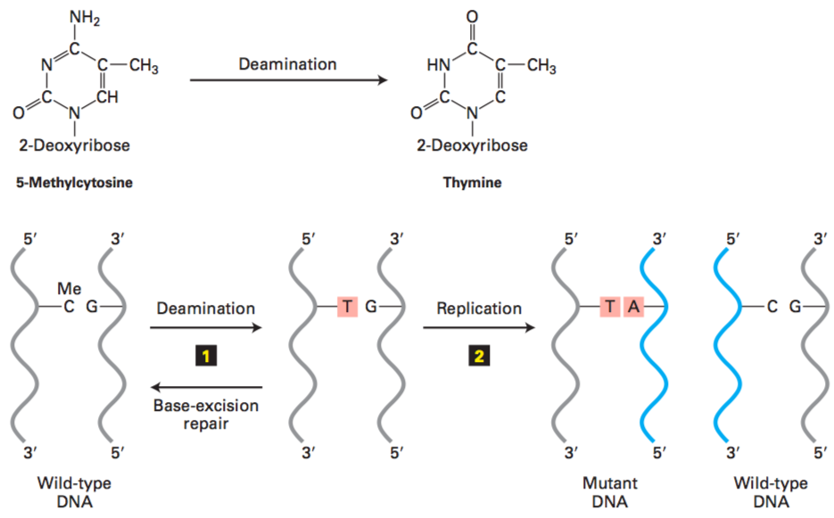
Chemical and Radiation Damage in DNA Can Lead to Mutations
Deamination leads to point mutations. A spontaneous point mutation can be caused by deamination of 5-methylcytosine (C) to form thymine (T). If the resulting T∙G base pair is not restored to the normal C∙G base pair by base excision-repair mechanisms 1 , it will lead to a permanent change in sequence (i.e., a mutation) following DNA replication 2 . After one round of replication, one daughter DNA molecule will have the mutant T∙A base pair and the other will have the wild-type C∙G base pair.

Slide 9
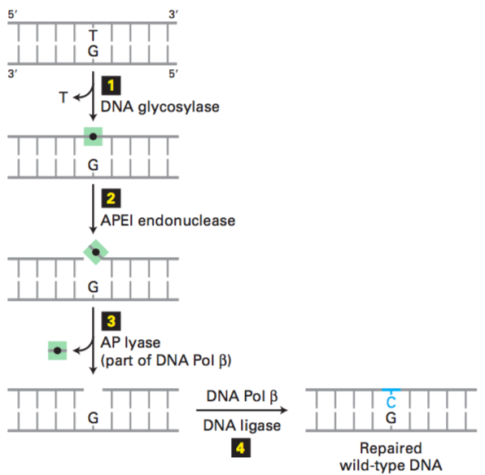
High-Fidelity DNA Excision-Repair Systems Recognize and Repair Damage
Base excision repair of a T∙G mismatch. A DNA glycosylase specific for G∙T mismatches flips the thymine base out of the helix and then cuts it away from the sugar-phosphate DNA backbone (step 1), leaving just the deoxyribose phosphate (black dot). An endonuclease specific for the resultant abasic site (apurinic endonuclease I, APE1) then cuts the DNA backbone (step 2), and the deoxyribose phosphate is removed by an endonuclease, apurinic lyase (AP lyase) associated with DNA polymerase β, a specialized DNA polymerase used in repair (step 3). The gap is then filled in by DNA Pol β and sealed by DNA ligase (step 4), restoring the original G∙C base pair.

Slide 10
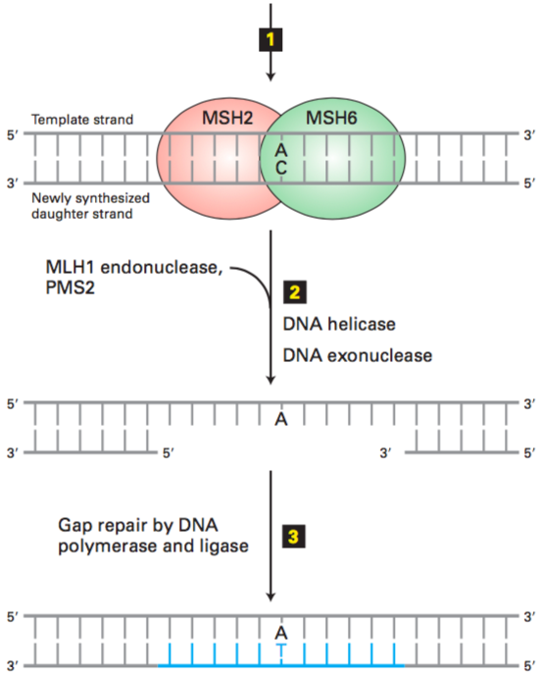
Mismatch Excision Repairs Other Mismatches and Small Insertions and Deletions
Mismatch excision repair in human cells. The mismatch excision-repair pathway corrects errors introduced during replication. A complex of the MSH2 and MSH6 proteins binds to a mispaired segment of DNA in such a way as to distinguish between the template and the newly synthesized daughter strand (step 1). This binding triggers binding of MLH1 and PMS2. The resulting DNA-protein complex then binds an endonuclease that cuts the newly synthesized daughter strand. Next a DNA helicase unwinds the helix, and an exonuclease removes several nucleotides from the cut end of the daughter strand, including the mismatched base (step 2). Finally, as with base excision repair, the gap is filled in by a DNA polymerase (Pol δ, in this case) and sealed by DNA ligase (step 3).

Slide 11
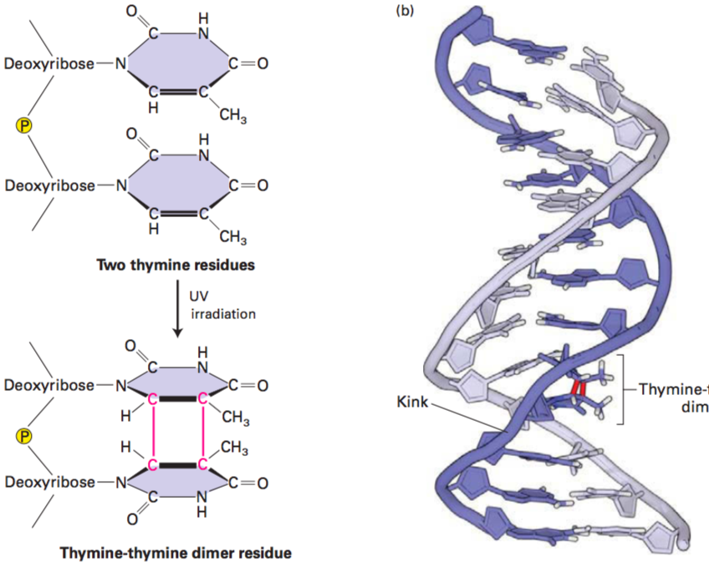
Nucleotide Excision Repairs Chemical Adducts that Distort Normal DNA Shape
Formation of thymine-thymine dimers. (a) The most common type of DNA damage caused by UV irradiation is the formation of thymine-thymine dimers. (b) These lesions can be repaired by an excision-repair mechanism that recognizes the distortion they create in the shape of the DNA double helix. The red lines in (b) represent the UV-induced C—C bonds shown in (a).

Slide 12
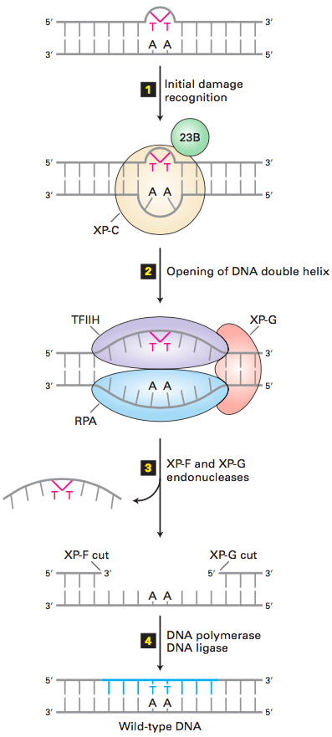
Nucleotide Excision Repairs Chemical Adducts that Distort Normal DNA Shape
Nucleotide excision repair in human cells. A DNA lesion that causes distortion of the double helix, such as a thymine- thymine dimer, is initially recognized by a complex of the XP-C (xeroderma pigmentosum C protein) and 23B proteins (step 1). This complex then recruits transcription factor TFIIH, whose helicase subunits, powered by ATP hydrolysis, partially unwind the double helix. XP-G and RPA proteins then bind to the complex and further unwind and stabilize the helix until a bubble of about 25 bases is formed (step 2). Then XP-G (now acting as an endonuclease) and XP-F, a second endonuclease, cut the damaged strand at points 24–32 bases apart on each side of the lesion (step 3). This releases the DNA fragment with the damaged bases, which is degraded to mononucleotides. Finally the gap is filled by DNA polymerase exactly as in DNA replication, and the remaining nick is sealed by DNA ligase (step 4).

Slide 13
Post-Replication Repair
• Post-replication repair– Discovered in E.
coli by Miroslav Radman
– Responds when damaged DNA escapes
repair and the damage disrupts replication
– Rec A protein stimulates recombination
between donor strand and new strand
– Creates gap in donor strand which can
be repaired
– DNA Polymerase and DNA Ligase involved in
this process.

Slide 15
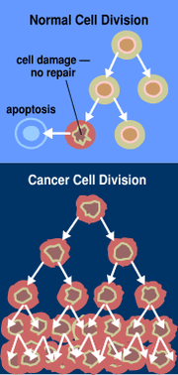
Role of Cell Division in Cancer
Top = normal cell division
Bottom = unregulated cell division and tumor formation
Malignant
If tumor invades surrounding tissue (cancerous)
Benign
If tumor has no effect on surrounding tissue
(non-cancerous)
Metastatic
If individual cells break away and start a new tumor elsewhere
(cancerous)

Slide 16
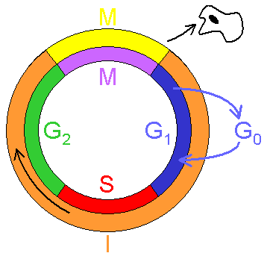
Review: The cell cycle has four phases and controls cell division
Two gap or growth phases (G1 and G2)
S phase - DNA synthesis
M phase - Mitosis
Interphase
16

Slide 17
Cell Cycle Checkpoints
Three checkpoints in cell cycle
G1-S transition
G2-M transition
Exit M phase transition
Checkpoints are where the cell assesses whether conditions are favorable for cell division.
When the environment is not favorable (for example, when the cell’s DNA is damaged), a protein called p53 can stop the cell cycle and cause the cell to die.
When the proteins that regulate the cell cycle are mutated or absent, cells can divide uncontrollably, leading to cancer.
17

